Slide 1


STUDENT’S E-CORNER
Computer Science and Engineering
R.Mamatha
G.Shilpa
P.Srilatha
Supervisor:Laxmi Narayana Sir

Slide 2
Table of contents
INTRODUCTION
KEY FEATURES
BENEFITS
USER INTERFACE
ADMIN INTERFACE
DATABASE SCHEMA
OVERVIEW
CONCLUSION

Slide 3
Introduction
Student’s E-corner is a sophisticated online platform designed to facilitate the exchange of essential PDF documents between faculty members and students within an educational institution.
This platform harnesses the power of technology to simplify and enhance the process of resource distribution, enabling a more efficient and collaborative learning environment.
Student e-platforms will offer convenience and flexibility for both students and educators.

Slide 4
Key Features
Our website has features for both Admin and Student.
Admin Features
Admin Dashboard.
Admin can view all the courses available for different branches
Admin can upload resources for the respective subject.
Student Features
Student can signup with Username and Password.
After login with credentials student can able to access the portal.
Students can able to access the subjects in respective branch and download the content.

Slide 5
Benefits
E-Learning & Distance learning.
Gives Students hands-on-experience.
Self Directed Learning
User Management & Accounts
Flexibility
Cost Effectiveness

Slide 6
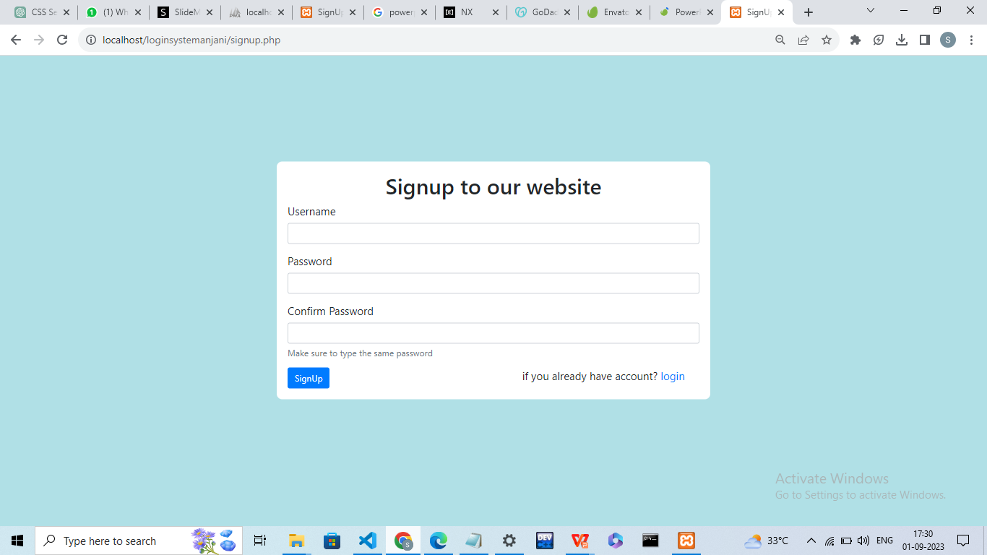
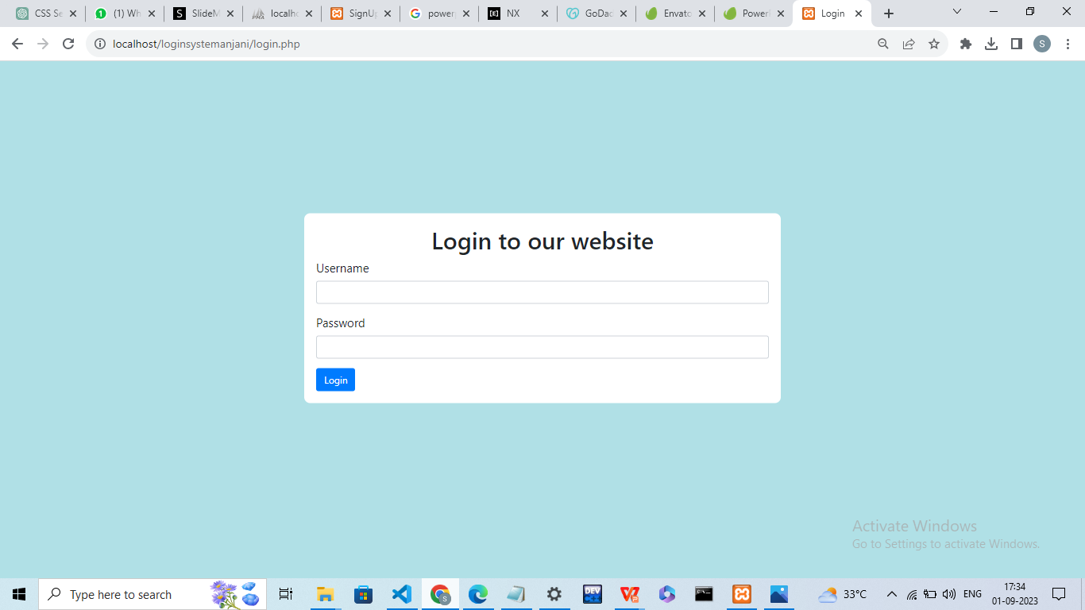
USER INTERFACE
signup
login

Slide 7
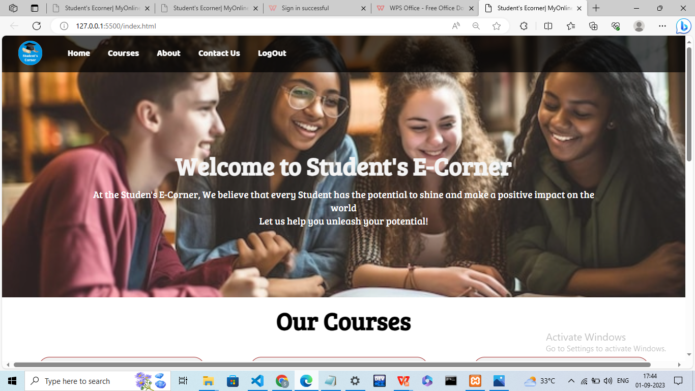
HOME PAGE

Slide 8
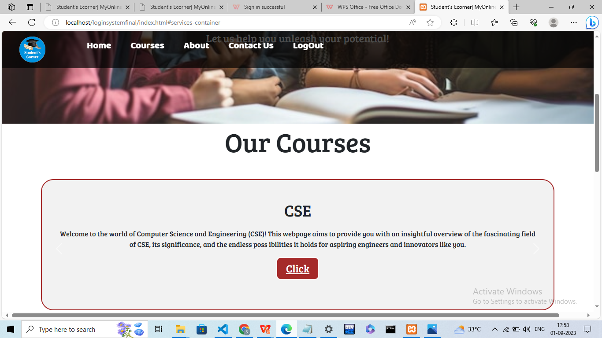
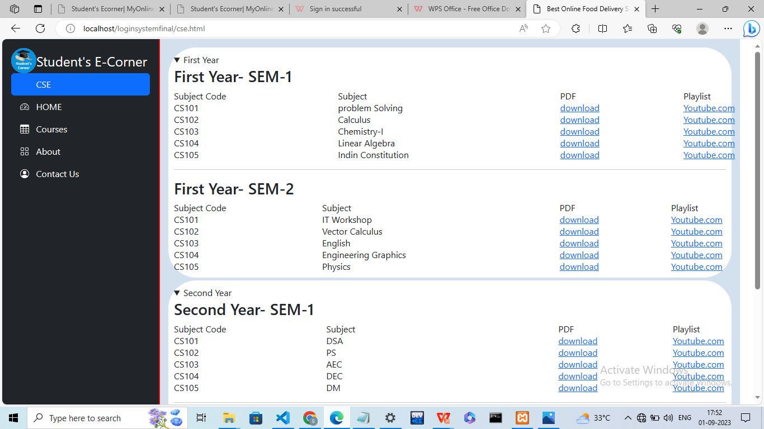
COURSES

Slide 9
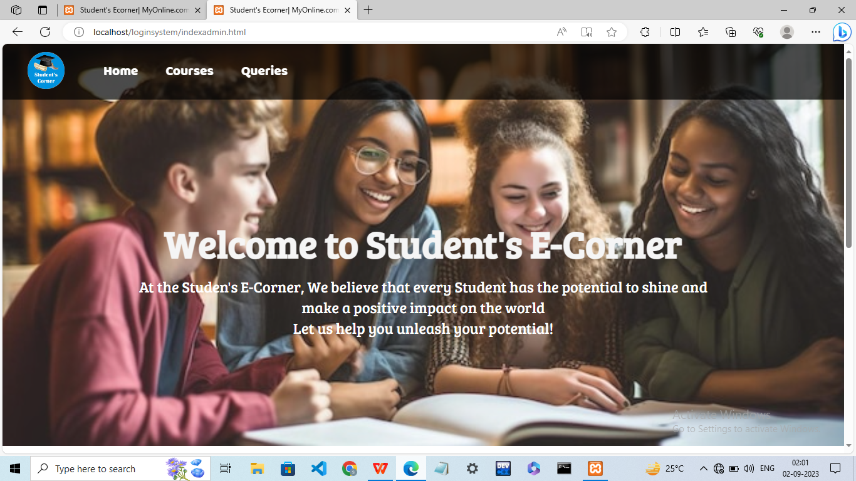

Slide 10
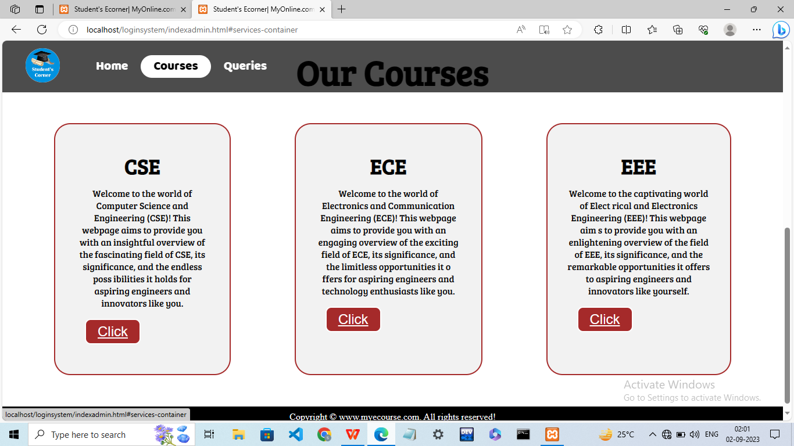

Slide 11
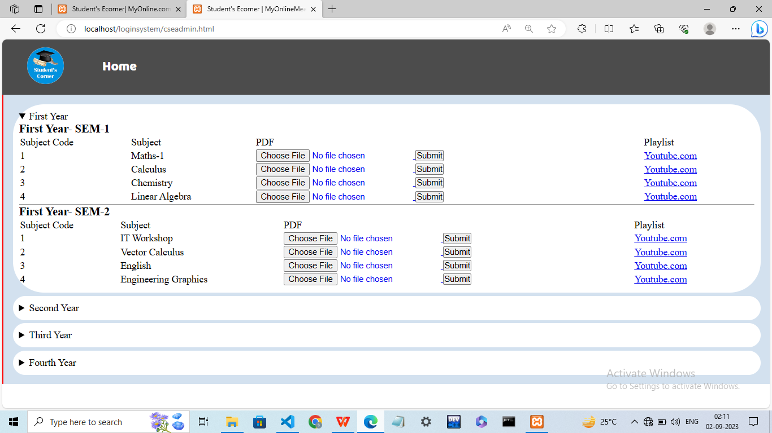

Slide 12
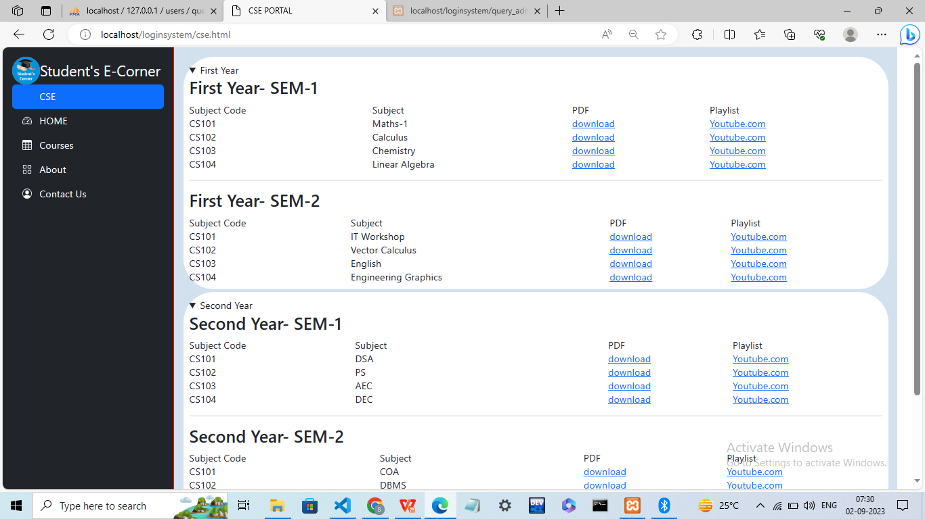
CSE PORTAL

Slide 13
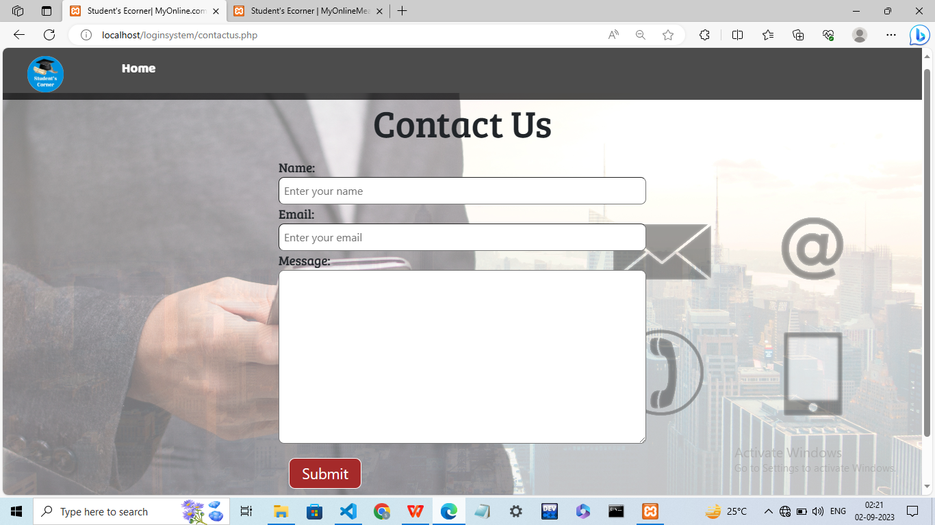
Any Queries?

Slide 14
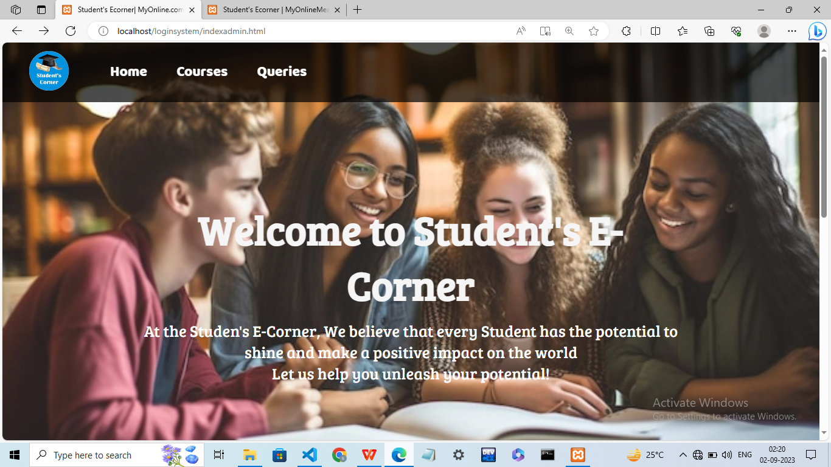
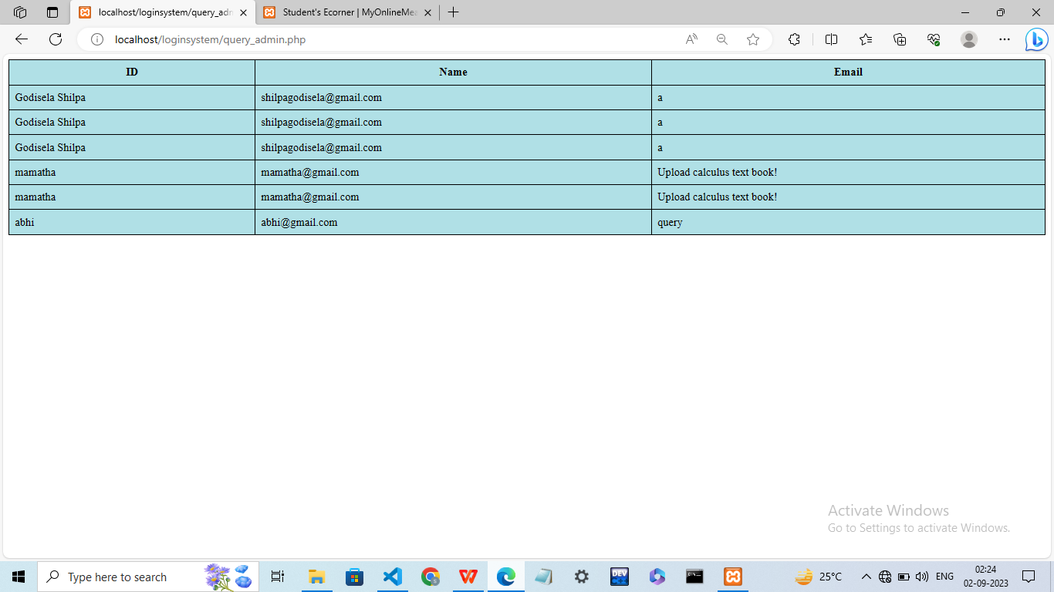

Slide 15
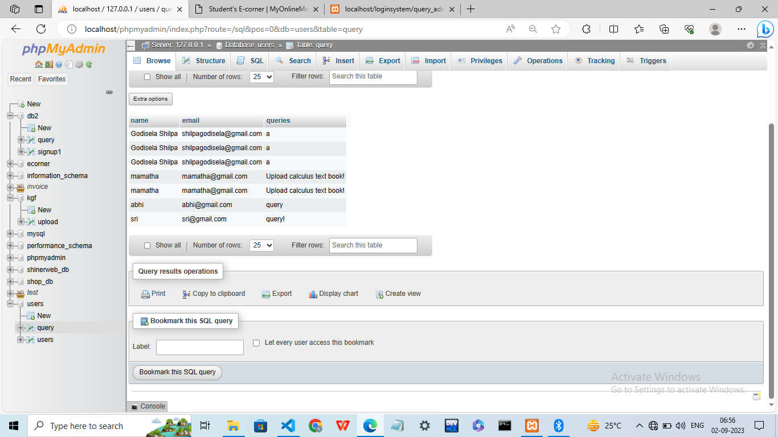
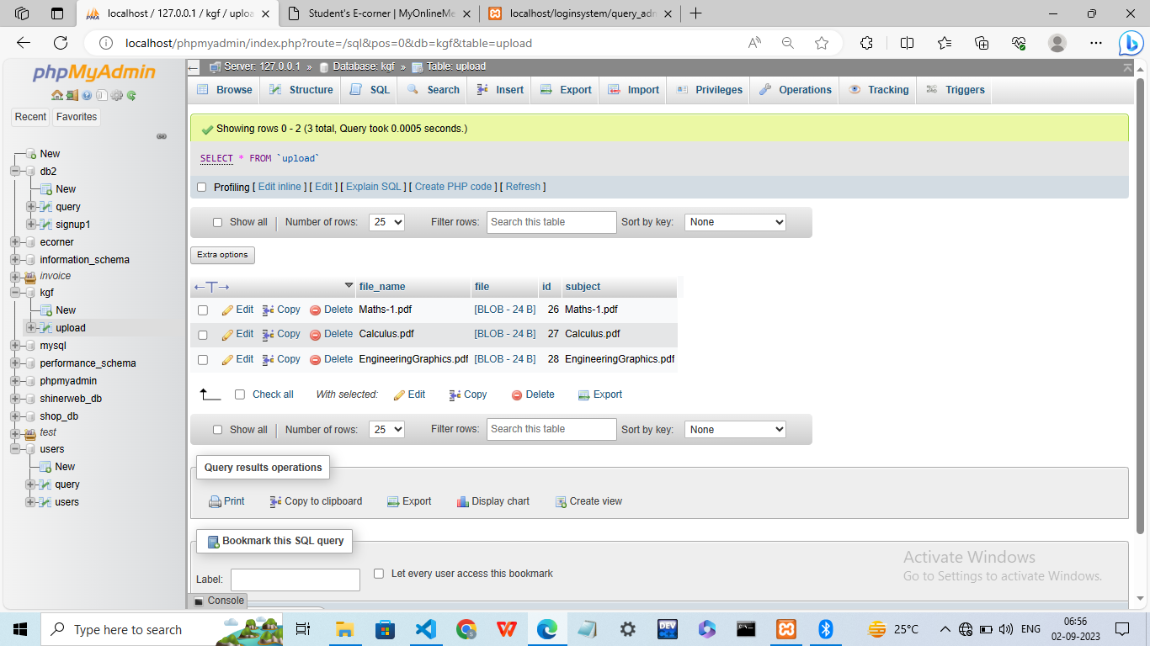
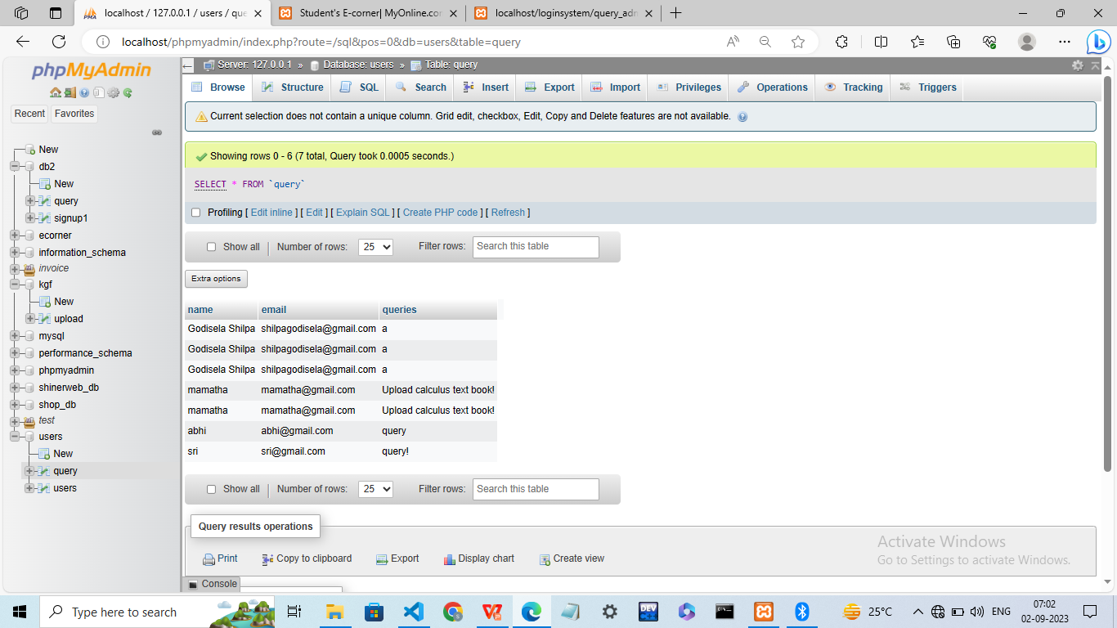
Databases

Slide 16
CONCLUSION
In conclusion, the Student E-Corner Website serves as a valueble resource for students,offering wide range of educational materials to enhance their learning experience.This platformis provides the organized way of accessing the resources and designed to empower students on their educational journey.
During this project we learnt more about backend such as PHP and configuring the database with the application.
This can be enhance in future by creating the discussion forum among the users so that they can share their respective thoughts. and post their answers.

